Slide 1
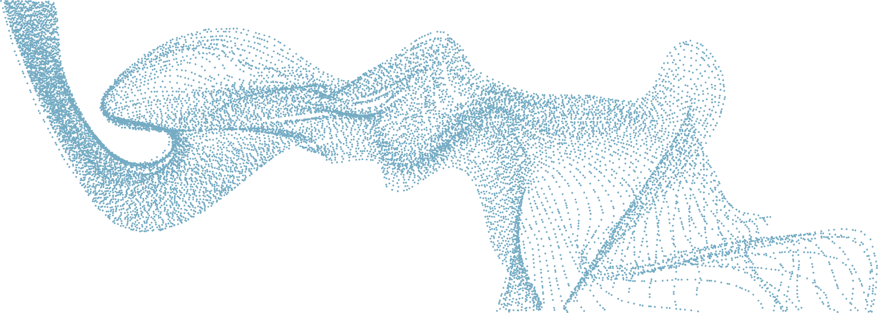


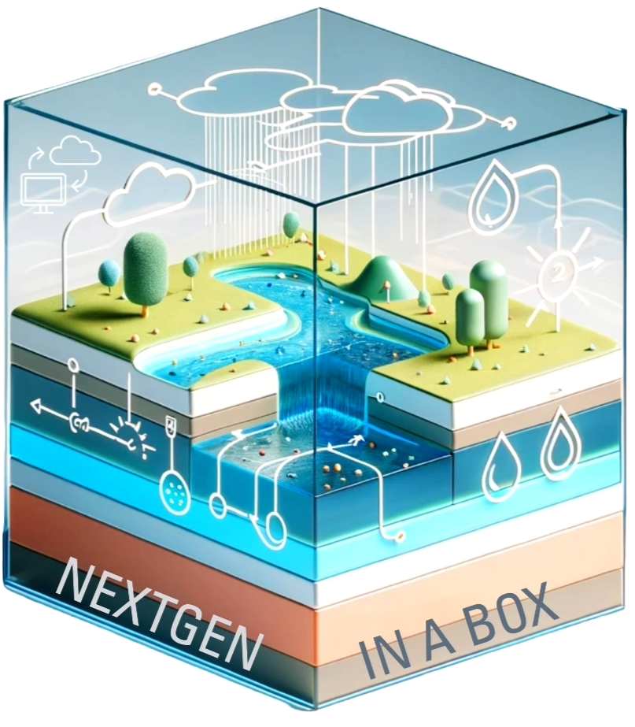
ALWRC 2025:
Advancing Hydrologic Modeling through Community-Driven Development: The NextGen Framework
Arpita Patel, James Halgren, Steven Burian
The University of Alabama
Jordan Laser, Zach Wills, Nels Frazier
Lynker
Notes:
Abstract
Advancing Hydrologic Modeling through Community-Driven Development:
The NextGen Framework The NextGen Water Resources Modeling Framework (NextGen) represents a significant advancement in hydrologic modeling. This study introduces the "Community NextGen" initiative, a collaborative effort by the University of Alabama and Lynker, aimed at fostering open innovation and accelerating the framework's development. Our project focuses on four key areas: (1) establishing a CIROH Community Fork of NextGen to promote open governance and community-driven development; (2) developing NextGen In A Box (NGIAB) and DataStream, a deployable laboratory workbench for experimenting with localized configurations; (3) utilizing robust model evaluation functionality; and (4) implementing comprehensive testing and continuous integration/delivery pipelines. These efforts aim to facilitate efficient research-to-operations and operations-to-research transitions, ultimately enhancing our ability to model and predict water resources at various scales. By fostering a collaborative ecosystem around NextGen, we seek to harness the collective expertise of the hydrologic community, driving innovation and improving the framework's applicability to diverse water management challenges. This study will focus on the strategies for community engagement, including the development of standards and guidelines, and share insights from case studies utilizing NGIAB, DataStream as an experimental platform, and demonstrating the potential for accelerating the integration of research insights into NOAA operational forecasting.

Slide 2

Next Generation
Water Resources Modeling Framework (NextGen)
NextGen developed by the NOAA OWP at the National Water Center
A model-agnostic, standards-based framework for water resources modeling that enables seamless coupling and interoperability between different hydrological models and modules.
Multi-Language Support - C++, C, Fortran, Python
Designed to provide multi-model hydrologic prediction advances for the National Water Model (NWM)
NWM provides hydrologic predictions for over 2.7 million river reaches across the US.
NextGen GitHub Repository:
GitHub: NOAA-OWP/ngen
NextGen Wiki:
GitHub: NOAA-OWP/ngen/wiki

Slide 3

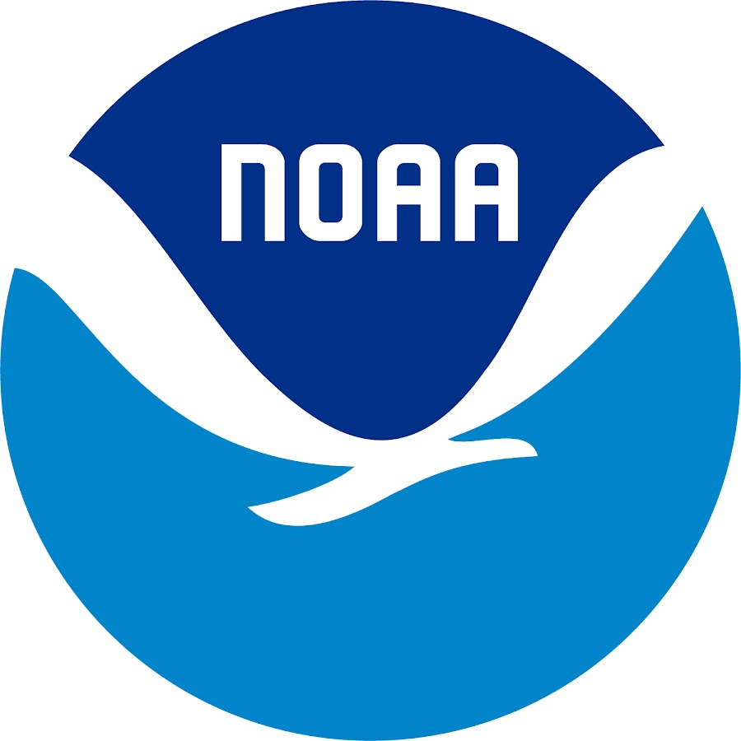
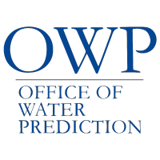
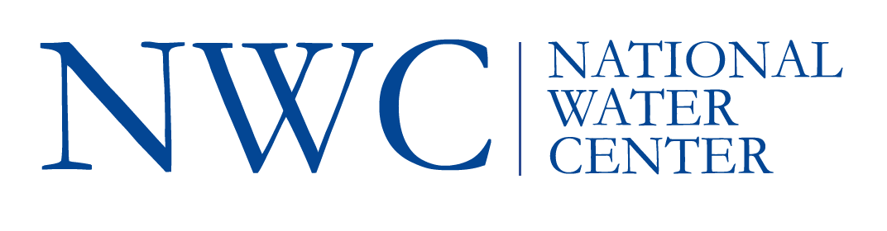
What is NGIAB (NextGen In A Box)?
ready-to-run, containerized, and cloud-friendly version of the NextGen Water Resources Modeling Framework.
Developed by CIROH, Lynker
1. Open-source
2. Community tool
3. Accelerate Research
4. Pathway towards R2O

Slide 4

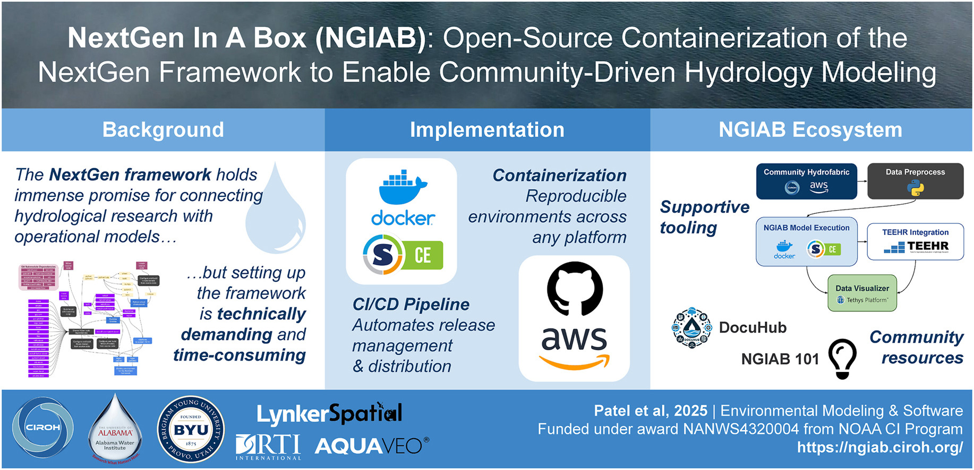
NGIAB Journal Paper published in EMS
https://www.sciencedirect.com/science/article/pii/S1364815225003500

Slide 5
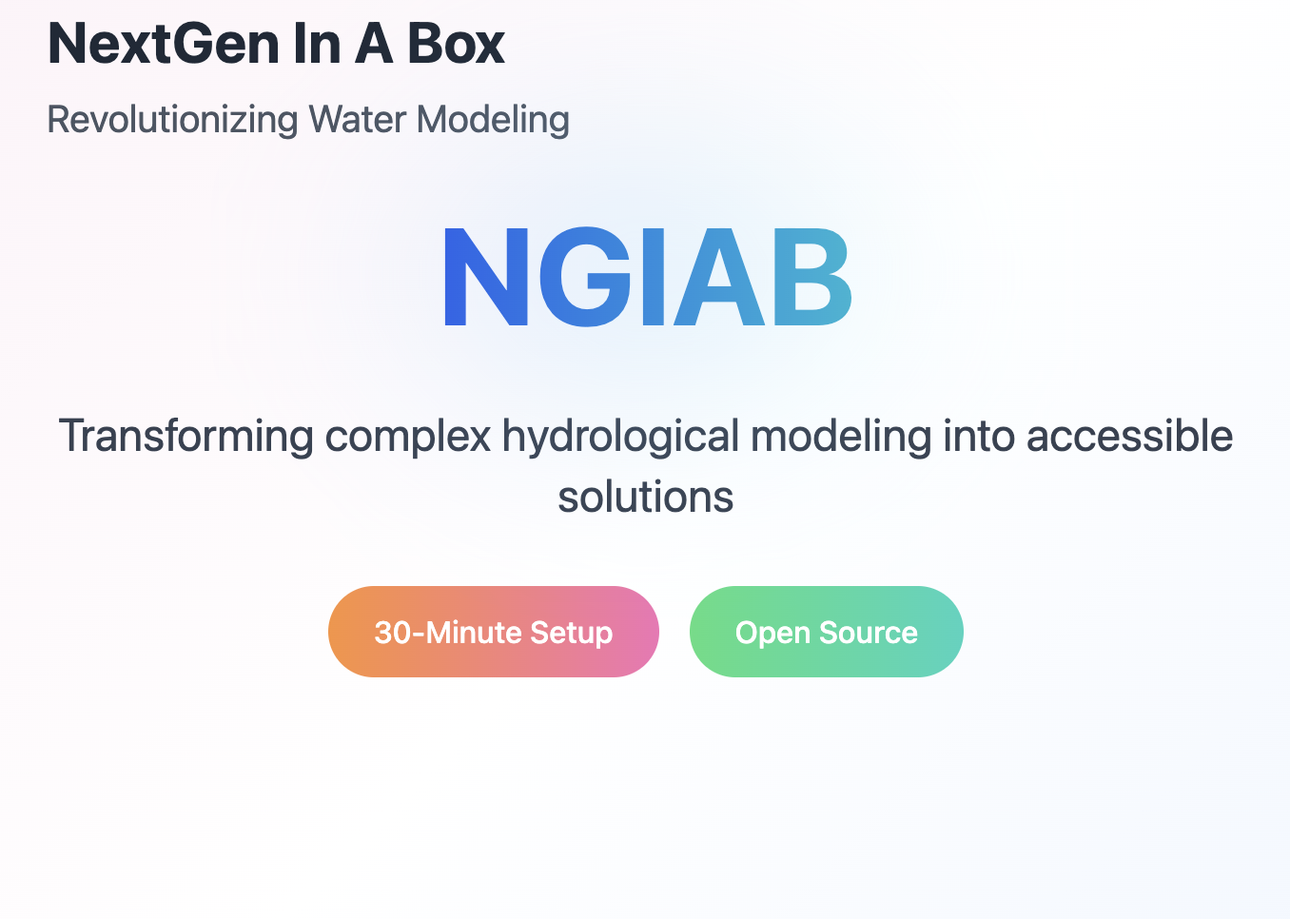
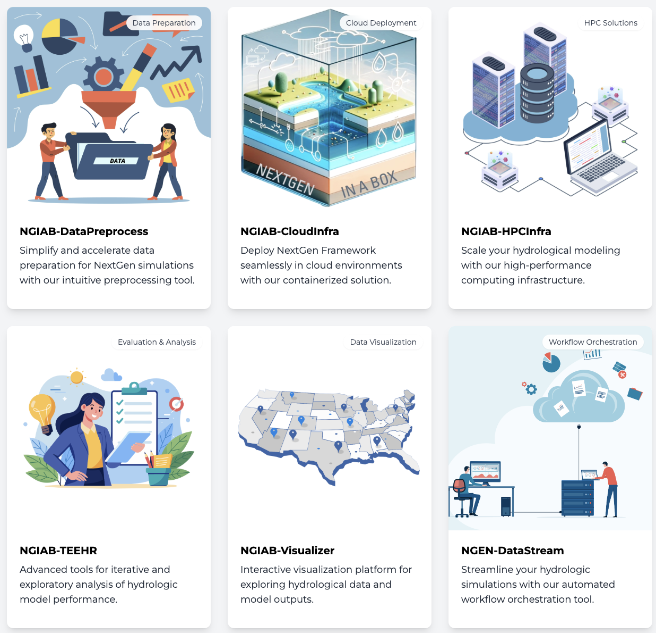
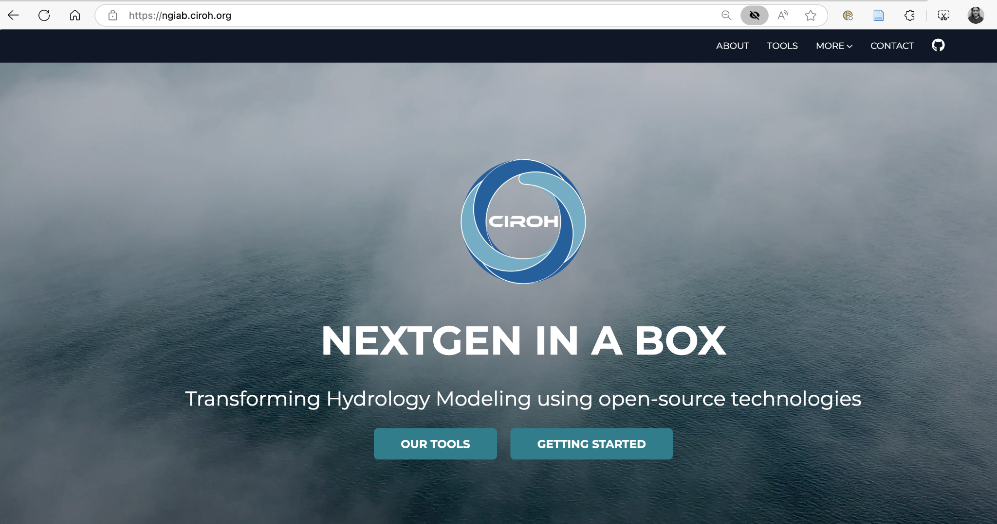
NGIAB Product Portfolio website
ngiab.ciroh.org

Slide 6
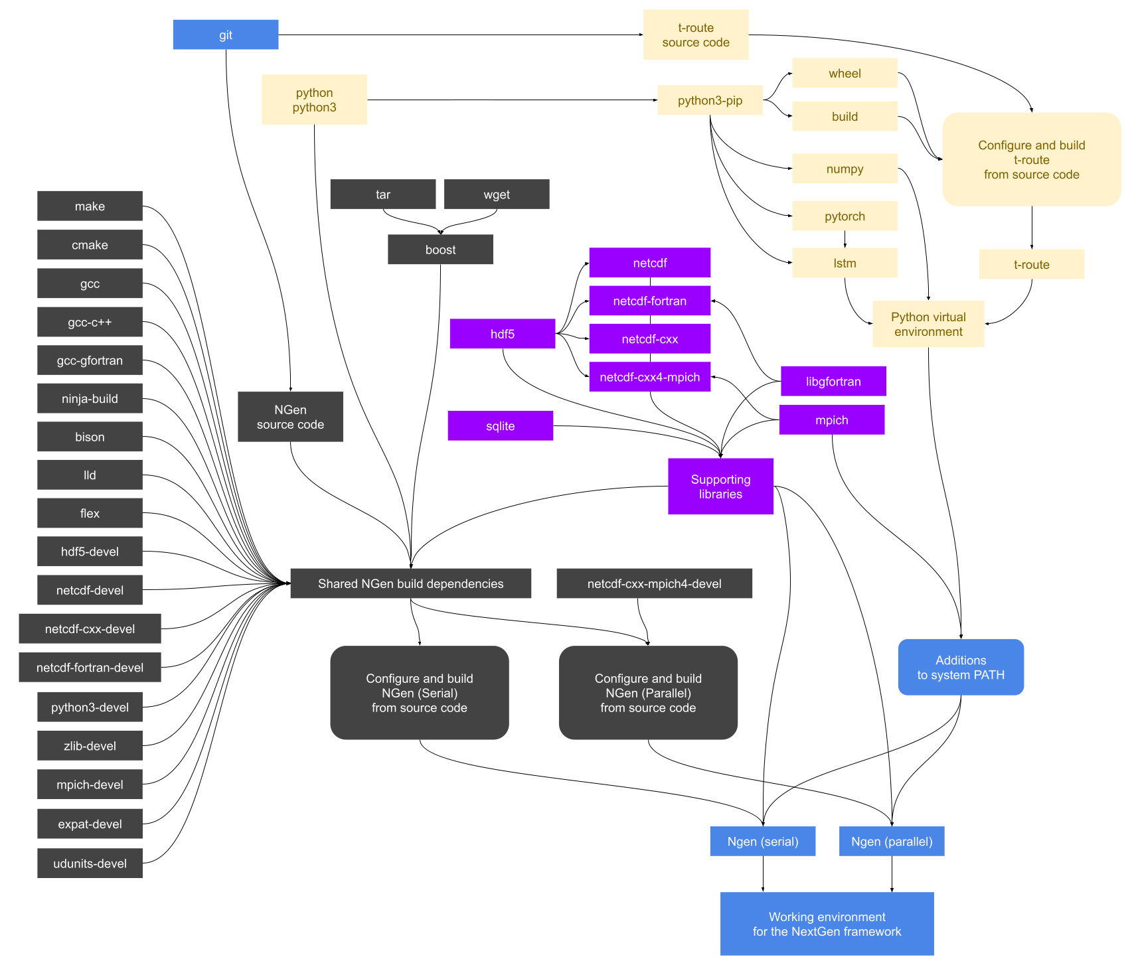
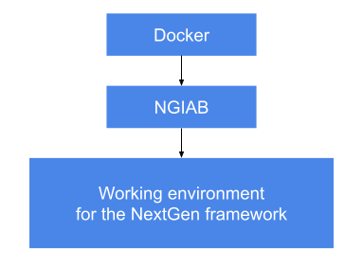
Why to use NGIAB?
NextGen build tracing
NGIAB
Notes:
\

Slide 7

NGIAB Data Preprocess
This tool prepares data to run a NextGen simulation by creating a run package that can be used with NGIAB.
Uses Hydrofabric 2.2
Repo : https://github.com/CIROH-UA/NGIAB_data_preprocess
Easy Map based tool to create CFE-based NextGen realizations with all necessary inputs.
Commands:
uvx --from ngiab_data_preprocess cli -i gage-10154200 -sfr --start 2017-09-01 --end 2018-09-01 --source aorc
uvx --from ngiab_data_preprocess map_app
uvx ngiab-prep -i gage-02464000 --start 2010-01-01 --end 2015-01-02 --lstm --source aorc -sfr

Slide 8

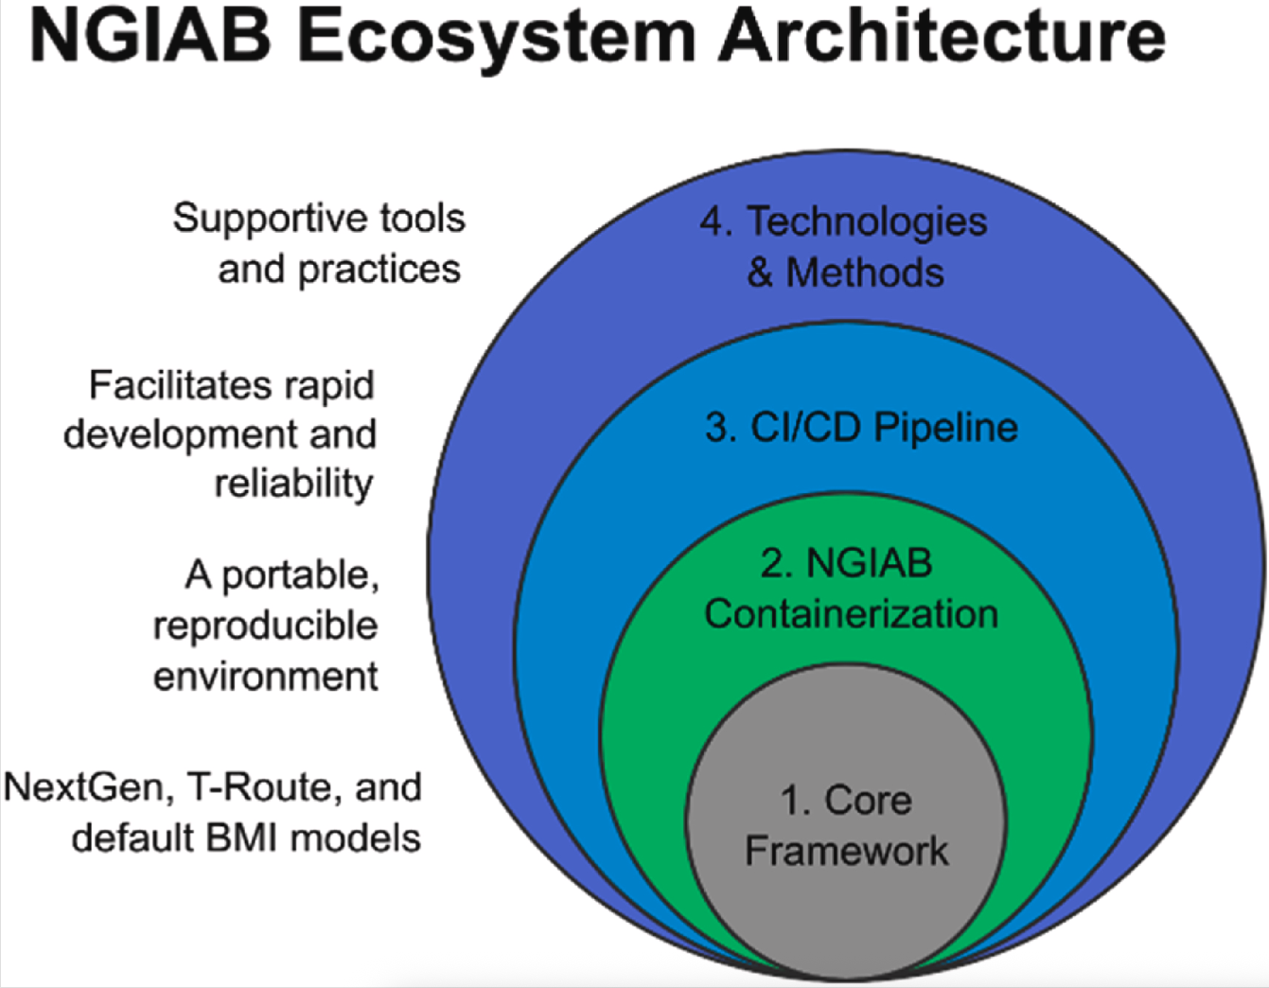
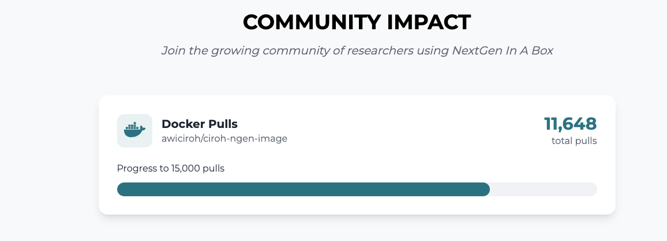
NextGen In a Box (NGIAB)
Open-Source Technologies
GitHub
GitHub Actions - CI/CD yaml files
Docker - Dockerfile
Singularity
Shell Scripting
Provides seamless model coupling and interoperability via the BMI standard within NextGen.

Slide 9
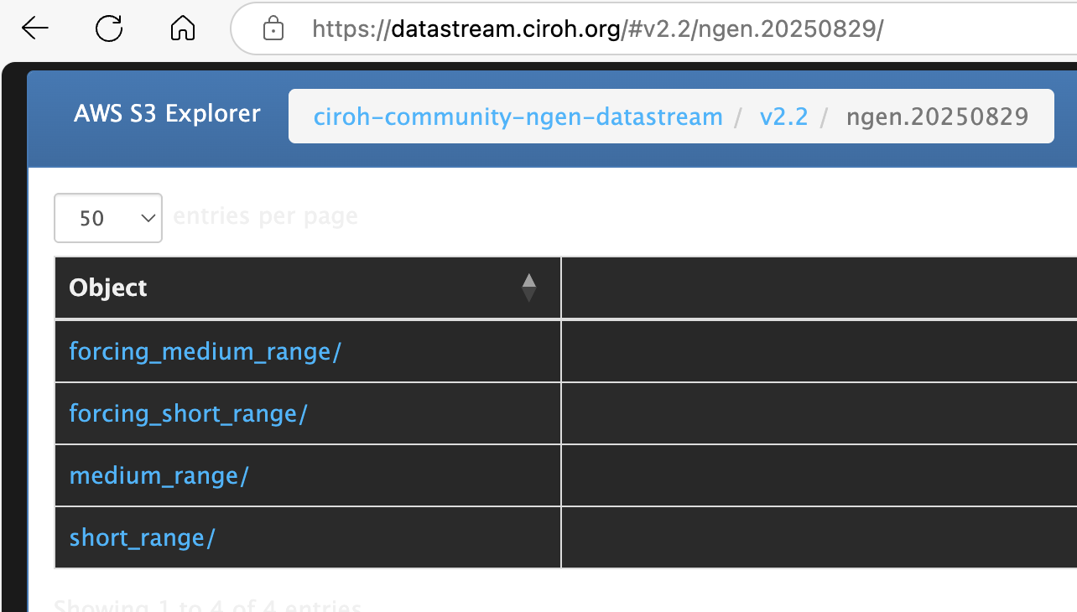
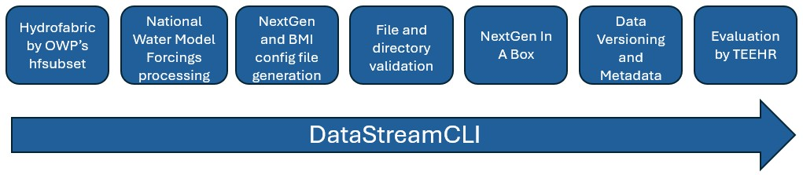
NextGen Research DataStream (NRDS)
https://datastream.ciroh.org/ -
Daily output from NGIAB on AWS S3 bucket for CFE + NOM
VPU_16 – calibrated
Other VPUs – uncalibrated
Open for community contribution!
your calibrated parameters could make it to future executions!!!

Slide 10
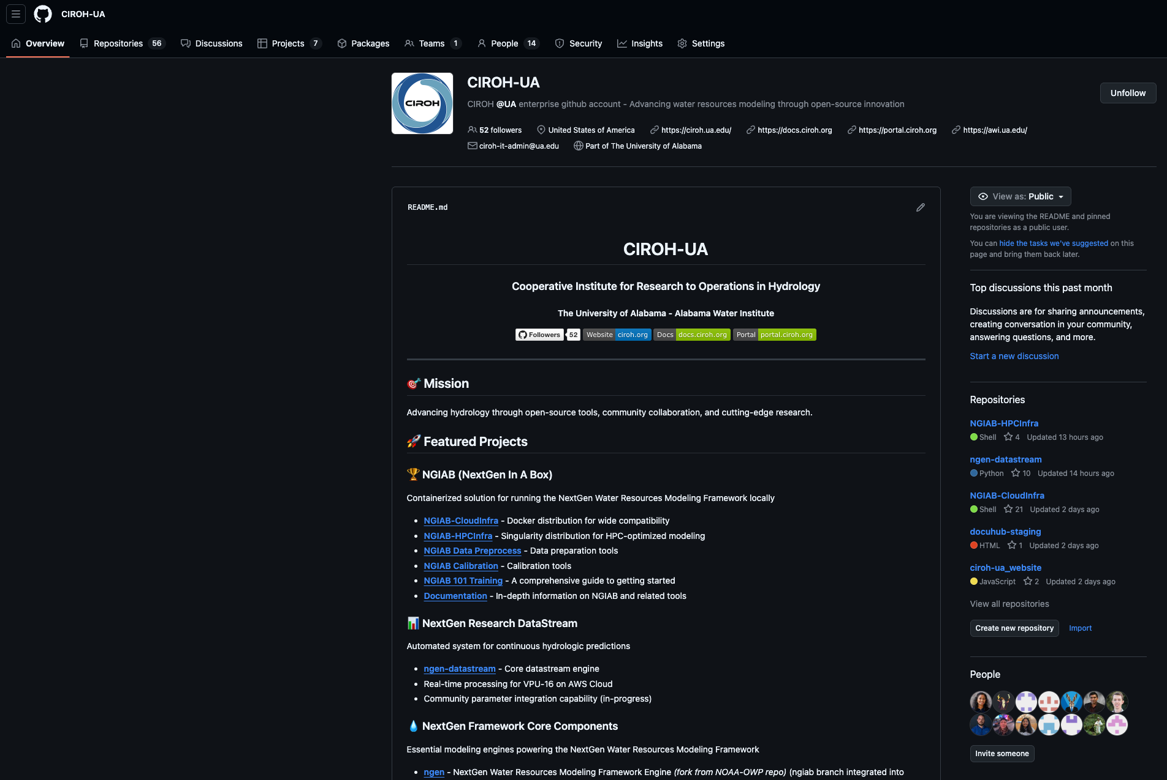
NGIAB and NRDS related repos

Slide 11
Thank You!
Acknowledgement
This research was supported by the Cooperative Institute for Research to Operations in Hydrology (CIROH) with funding under award NA22NWS4320003 from NOAA Cooperative Institute Program. The statements, findings, conclusions, and recommendations are those of the author(s) and do not necessarily reflect the opinions of NOAA.

